Slide 1
Solution approach and algorithm
How does your system work?
Team: HackHive Members: Abhinav [add the other team members]
Our approach free form
Assumptions and choices free form
1 Read plan
drawing units → metres; add 1 device per room
2 Grid
0.1 m lines + a line through every device
3 Zones
exact search: fewest hubs, rules 2 + 3
4 Hub points
exact ring cost at every legal point
5 Rings
leg-by-leg Dijkstra that pays the real J
6 Clean-up
rip-up + reroute, then re-measure all
Devices: one per living room, bedroom, kitchen and storage room; none in bathrooms, balconies or stairs. At the room centre, or the nearest point ≥ 0.5 m from walls and windows.
Cable: inside the plan outline on the 0.1 m grid, never through walls or windows, between rooms only through door or open-passage gaps; it may cross any room.
Hub point: a grid point in a room of its own zone, ≥ 0.5 m from walls and windows, with the cheapest exact ring; it may sit right next to its only device.
One-door room: the ring goes in and out on parallel lines 0.1 m apart, or on the same line when cheaper (then counted as overlap). A U-turn at a device is 1 bend.
Rule 3: rooms count as linked through doors or open passages (wall-free gap ≥ 2 × wall depth), not windows; the chain may pass through any room. The strict reading is kept as an option.
Our readings: a crossing is counted once per point, touches included; no wire passes through another hub or device; a room over 100 m² gets its own hub and is flagged invalid.
Hubs and zones: list every zone that fits rule 2 (≤ 5 devices, ≤ 100 m²) and rule 3 (rooms linked by doors or open passages, graph search), then an exact-cover search over all splits into k hubs, k = max(area/100, devices/5) rounded up, then k + 1, … The hub count is the fewest possible.
Hub point + node order: direction-aware Dijkstra from every device (state = grid point + heading, 0.5 per turn) and a min-plus DP over all visiting orders give the exact length + bends of the ring at every legal hub point. The cheapest point wins; its cost is a lower bound on J.
Routing: each leg is a Dijkstra on the grid whose step costs are exactly what it adds to J: length, 0.5 per bend, 1 per m on a used line, 5 for a new crossing. Other hubs and devices are blocked; an exact cost-to-go per arrival direction stops legs arriving the wrong way.
Crossings, overlap, bends: penalised inside the router; orders and zone splits are tried cheapest-bound first with branch and bound; then rip-up and reroute keeps a change only if J drops. An independent checker re-measures L, X, O, B from the output polylines.
Why: the router optimises the exact scoring formula, and exact lower bounds prove the hub count and let us prune without losing the best design.
Plain Python: one command turns every plan into JSON + an overlay image. No manual steps.
Intermediate update | Team: HackHive | 1 / 3

Slide 2
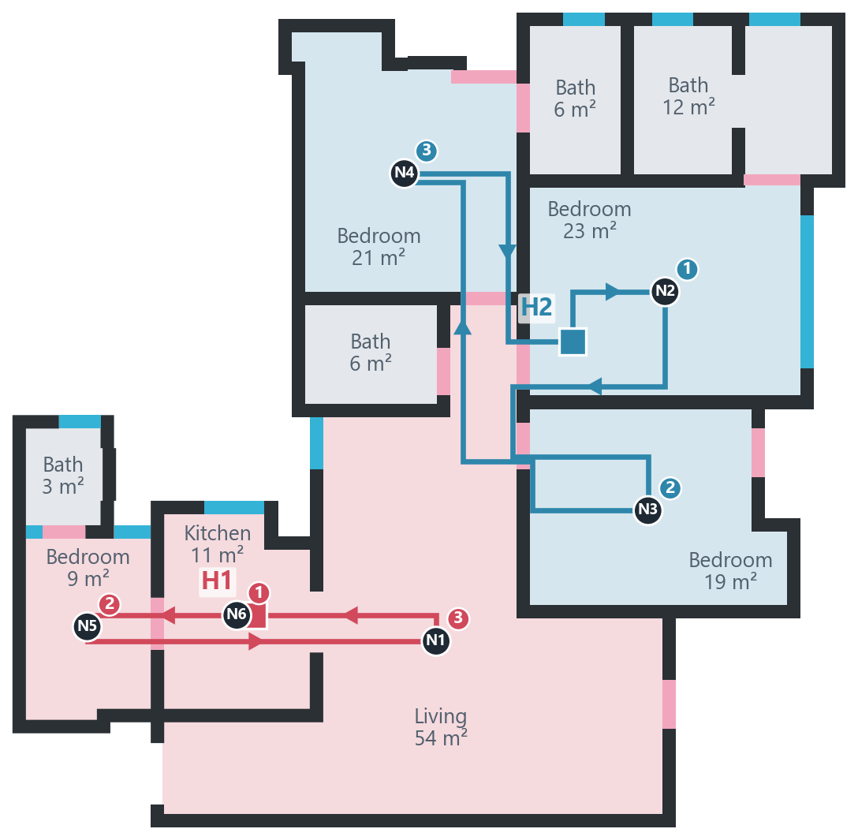
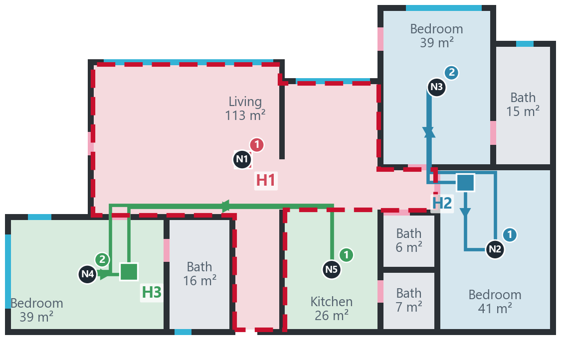
Current progress and screenshots
What works today? Show it, and show what does not.
Where we are free form
What works
The full pipeline in plain Python: plan → devices → zones → hubs → rings → JSON + overlay, for any set of plans.
Every one of the 1,516 test plans inside the benchmark is valid; the independent checker agrees on all.
Web app (Cable Ring Studio) shows any plan being solved live, stage by stage.
What does not work yet
46 plans outside the benchmark: 42 have a room over 100 m², 4 a sliver room or a device the cable cannot reach.
J is still 2.0 above our lower bound on average; the slowest plan takes 122 s.
Results (test split, 1,632 plans)
1,586 valid (97%); benchmark plans 1,516 / 1,516
Hubs: 1 in 888 plans, 2 in 660, 3 in 69, 4–5 in 12; fewest possible by construction
0 crossings in every plan; overlap 0.17 m on average
J median 43.5; rip-up and reroute cut J by 0.29 on average
6.5 s per plan (median, 1 core); ≈ 3 h for all 17,000 on 14 cores
The living room alone is 113 m² (outlined), over the 100 m² cap, so no split can meet rule 2.
We still route a full design (3 hubs, J 70.0, no crossings) and report rule 2 as broken.
42 of the 1,632 test plans have such a room. All are outside the organisers' benchmark.
2 hubs · J 56.46 (lower bound 54.96)
L 46.5 m · X 0 · O 0 · B 20 · valid
square = hub · dark dot = device · numbers = visiting order
Best result so far: PLAN_002969
A hard case: PLAN_000596, rule 2 impossible
Figures drawn from our output JSON. Results: ResPlan test split, 1,632 plans.
Intermediate update | Team: HackHive | 2 / 3

Slide 3
Remaining issues and improvements
What is left to fix, and what could go beyond the current scope?
Remaining issues current scope
Improvements beyond scope ideas, not built
Hidden-plan input format unknown. Could stop us. The deck does not show it; our loader reads ResPlan dicts and GeoJSON / WKT / coordinate lists. Fix: an adapter as soon as we see a sample.
J about 2.0 above our lower bound. Entering and leaving a one-door room on parallel lines costs a bend the bound ignores, and legs are routed one at a time. Fix: move hubs and swap visiting orders during clean-up.
Runtime tail. Big plans with many zone splits: p90 21 s, max 122 s (soft cap 90 s, hit once). Fix: reuse distance tables across splits, prune splits earlier. Matters if there is a time limit.
Plans outside the benchmark (46 / 1,632). Data limits: a room over 100 m², sliver rooms, sealed rooms. Rule 2 cannot be met there; we output the best design and name the broken rule.
Device points. We place our own (room centre). If the organisers give node points we use them unchanged; we need their format to be sure.
Bill of materials and cost: cable metres per hub, connectors and labour time, so an installer gets a quote straight from the plan.
What-if editing: drag a hub or device in the web app and re-route in seconds, to try layouts with the customer on site.
Real installation rules: runs along walls or ceilings, door frames, bend radius, keep-out zones such as wet rooms, a maximum ring length. The drawing can then be built as is.
Multi-floor buildings and CAD export: risers at stairs, DXF / IFC output for contractors.
Learned warm start: train on the 17,000 solved plans to predict zones and hub points, for large sites.
Next steps and help needed
Next, in order: 1. run all 17,000 plans (≈ 3 h) and check every benchmark plan is valid; 2. close the J gap (hub moves, order swaps) and cut the runtime tail; 3. package the one-command run and the web app for the demo.
Help needed: a sample input JSON for the hidden plans; any time limit per plan; a yes / no on our readings (rule 3 through any room, crossings once per point incl. touches, a hub right next to its only device).
Full notes, decisions and measurements: README.md and CLAUDE.md in the repository.
Intermediate update | Team: HackHive | 3 / 3

